Slide 1
LogView++
Software Alternative: Well Log Editing and Plotting
Sugiyanto Suwono
www.firagiel.com

Slide 2
Introduction
Software Development Kit:
Microsoft Visual C++ Express
CodeBlock
wxWidgets GUI Library
Fparser Library
Clipper Library
Paint.Net
Greenfish Icon Editor
KEL CHM Creator
InstallForge
BlueGriffon
Version History:
LogView++ 2010.12 (Dec 28, 2010)
LogView++ 2011.1 (Jan 24, 2011)
LogView++ 2012.1 (Sept 26, 2012)
LogView++ 2012.2 (Oct 10, 2012)
Main Features:
Log Editing
Completion Editing (2012.1)
Zone / Layer Editing (2012.1)
Template Editing
Log Plotting
Cross-Plotting (2012.1)

Slide 3
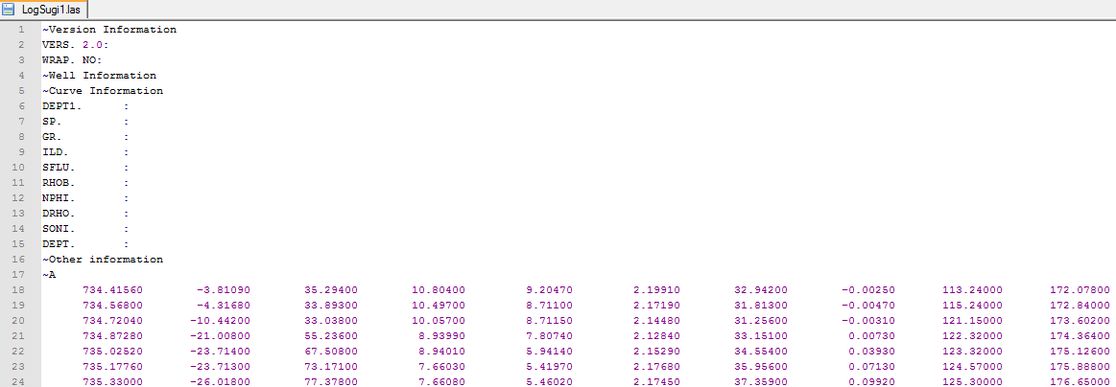
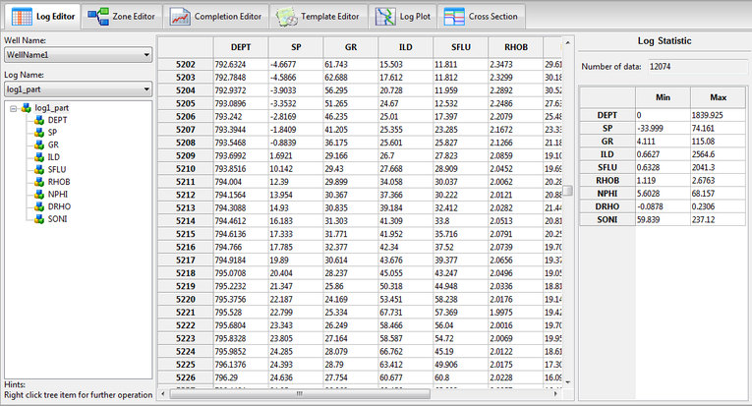
Basic Log Editing
Text Editor
LogView++

Slide 4
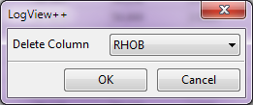
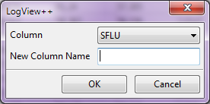
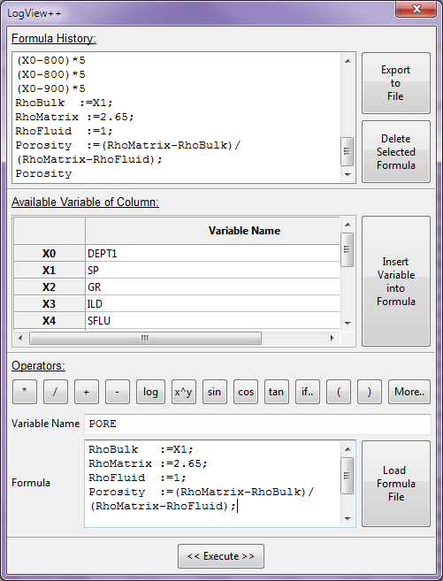
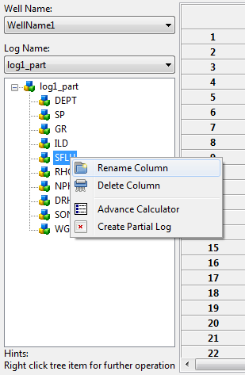
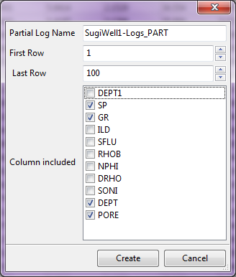
Basic Log Editing
Deleting Column
Renaming Column
Advance Calculator
Creating Partial Log

Slide 5
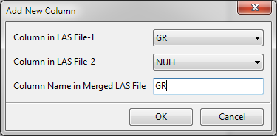
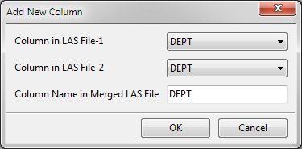
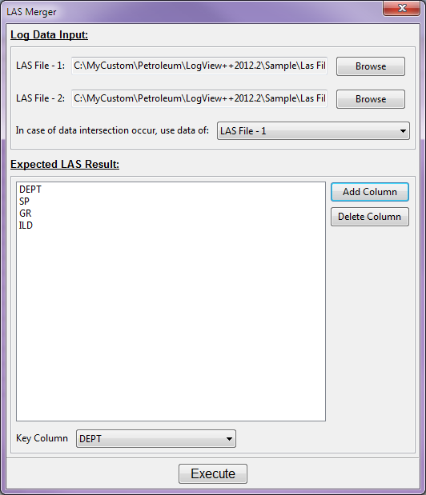
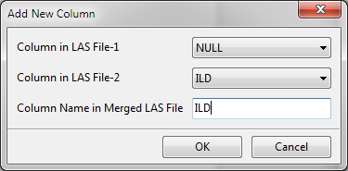
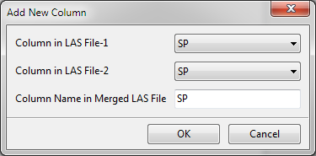
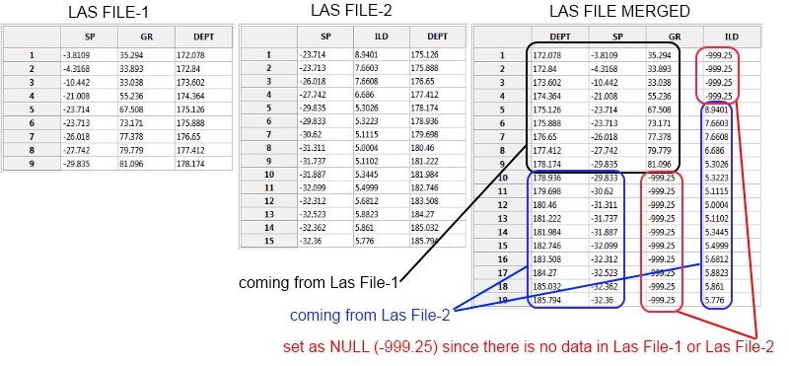
Basic Log Editing
Log Merging

Slide 6
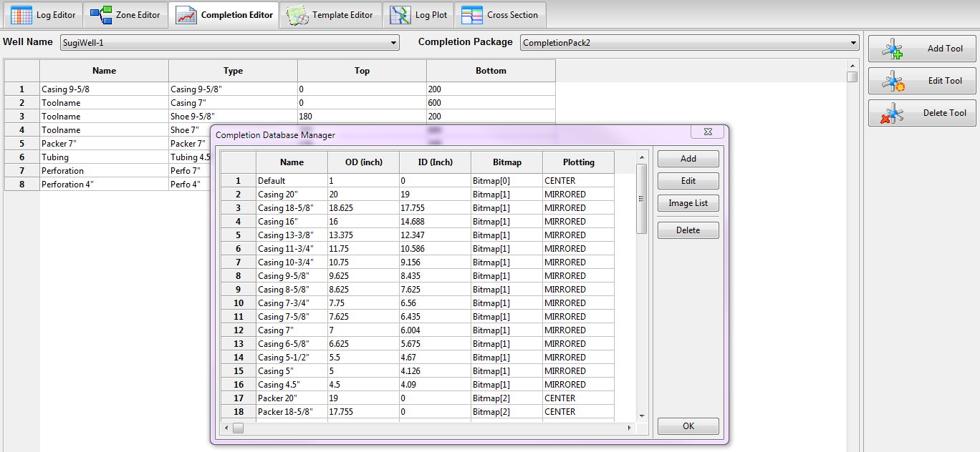
Completion Editing
Completion Package Manager
Multi-Completion Package Allowed
Completion Database Manager

Slide 7
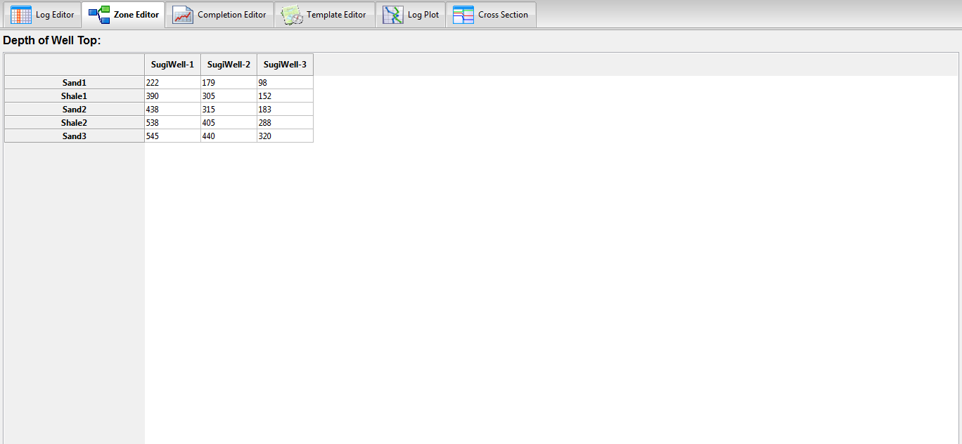
Zone / Layer / Well Top Editing

Slide 8
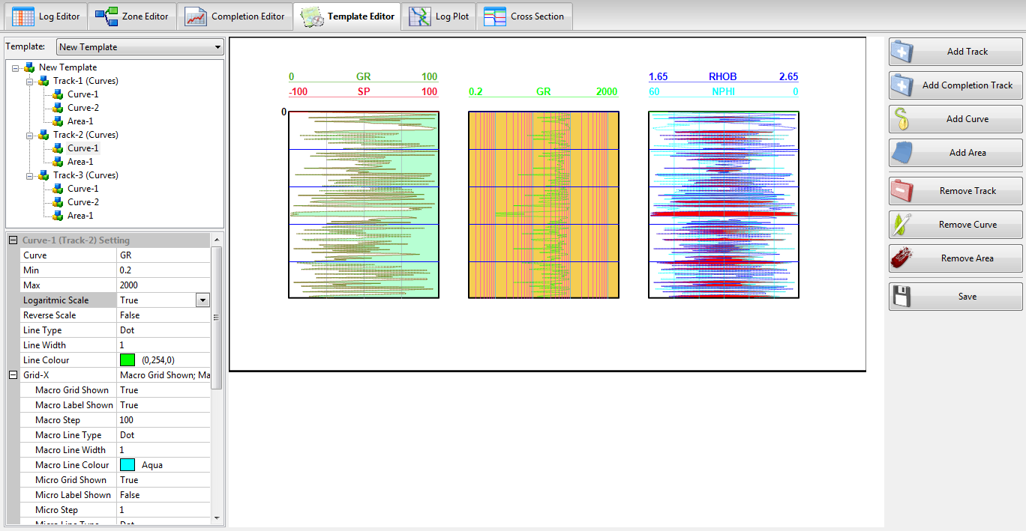
Template Editing
Track, Curve & Area
Preview
Properties

Slide 9
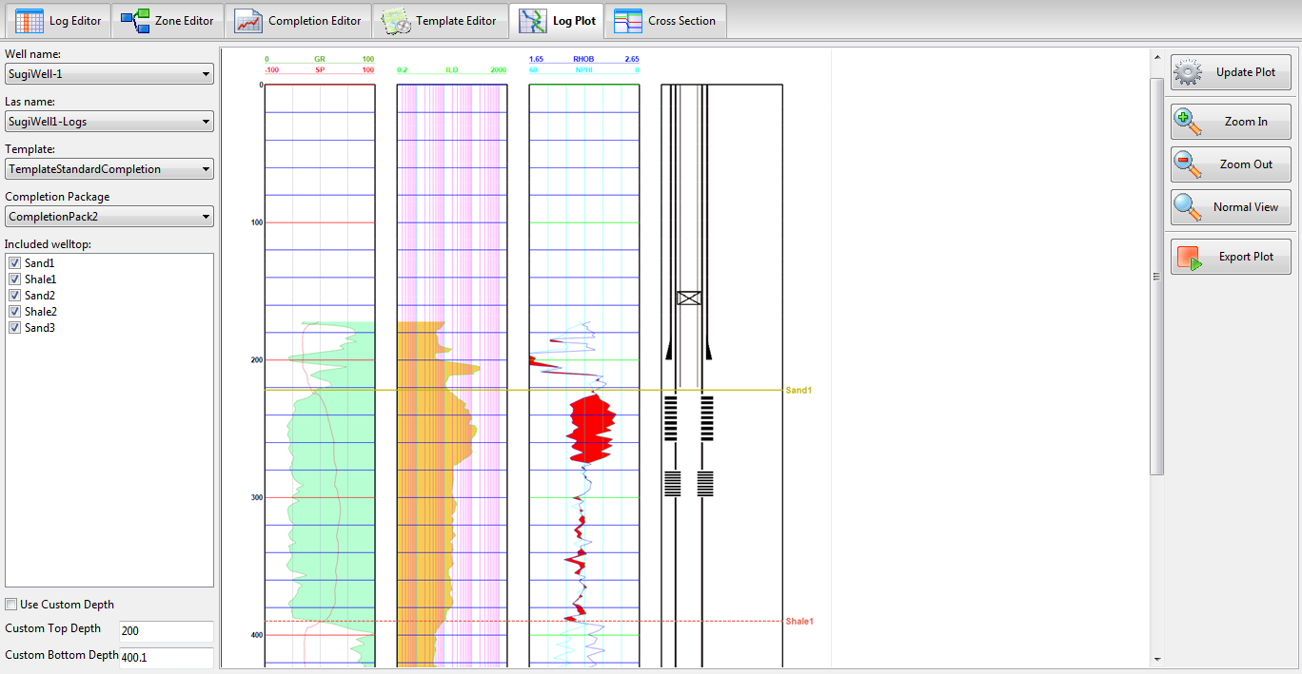
Log-Plotting

Slide 10
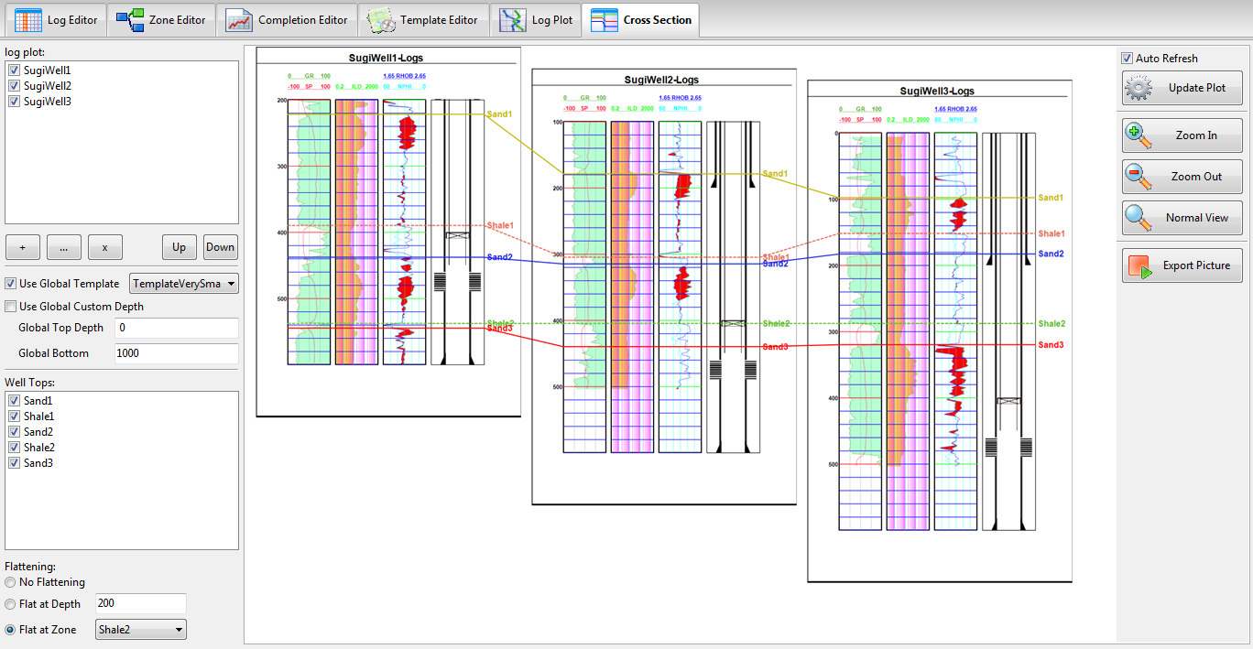
Cross-Section

Slide 11
Future Development
Next Feature Target:
Implementation of annotation in completion tools
Implementation of Integer Curve (i.e. Rock Description, Core Interval, etc.)
Implementation of Structure Map
Implementation of Cross Plot (Hingle, Picket Plot and etc.)
Combining to Agiel Neural Network (AgielNN) for advance log prediction using Neural Network
Anybody interested to join LogView++ development ??
LogView++ needs programmers (C++ or Python or Perl); tutorial, document & website maintainer; graphic designer; and many testers…

Slide 12
Thank You
Further question or found any bug, please visit blog and forum discussion in www.firagiel.com

